Slide 1
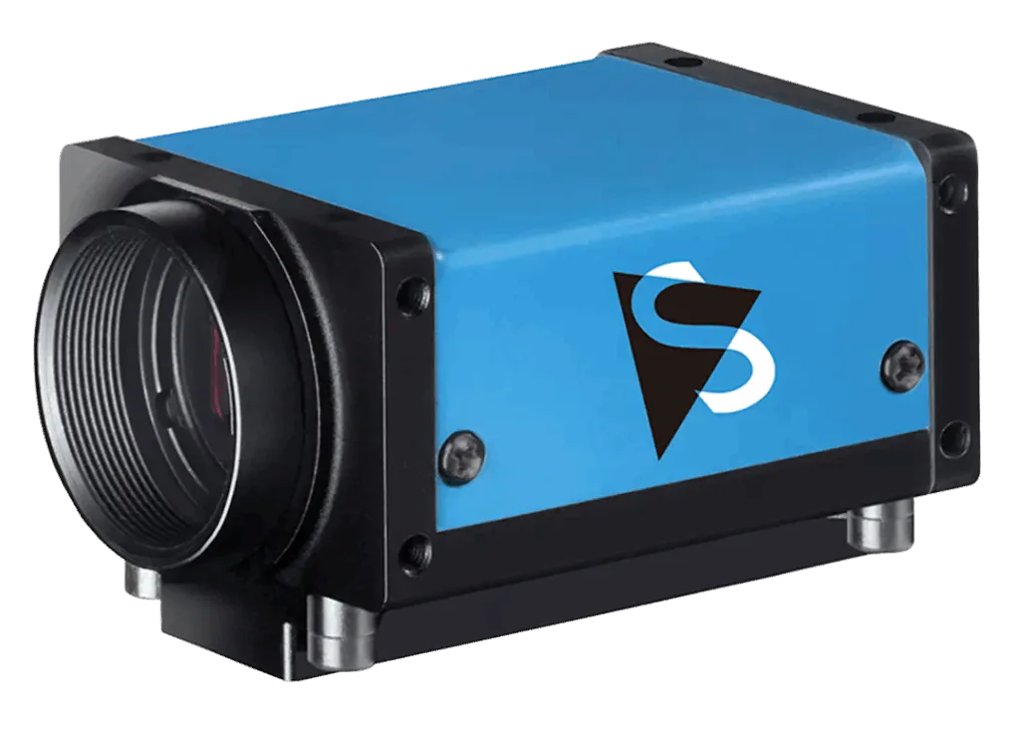
IMX 540 USB 3.1 Monochrome
Description
The IMX 540 is a high-resolution monochrome camera that features a cutting-edge Sony Pregius sensor for excellent image quality and sensitivity.
It is designed for high-speed imaging applications, ideal for industrial inspection, scientific imaging, and machine vision.
Equipped with a USB 3.1 interface, it offers fast data transfer and supports real-time image processing.
Specifications
Resolution - 5320x4600
Supply Voltage - 4.75 V to 5.25 V
Pixel Size - 2.74µm
Frame Rate - 15 (Full Resolution)
Applications
Industrial Inspection
Scientific Imaging
Machine Vision
Microscopy
Official Website :
https://shop.scorpion.vision/products/24-5-mp-1-2-imx540-usb-3-1-monochrome-camera

